Slide 1
Bangla Text Summarization
CSE 4120: Technical Writing and Seminar
Presented by
Supervised by
Arpita Kundu
Roll: 1907050
Year: 4th
Semester: 1st
Dr K. M. Azharul Hasan
Professor
Sunanda das
Assistant Professor
Department of Computer Science and Engineering
Khulna University of Engineering & Technology
Notes:
NOTE:
To change the image on this slide, select the picture and delete it. Then click the Pictures icon in the placeholder to insert your own image.

Slide 2
Paper Information
Table 1: Publications Summary
Serial No. | Title | Authors | Source | Published Year
01 | Bengali Text Summarization using TextRank, Fuzzy C-Means and Aggregate Scoring methods. | A. Rahman, F. M. Rafiq, R. Saha, R. Rafian and H. Arif | 2019 IEEE Region 10 Symposium (TENSYMP) | 2019
02 | Bengali News Abstractive Summarization: T5 Transformer and Hybrid Approach | K. M. Hasib, M. A. Rahman, M. I. Masum, F. D. Boer, S. Azam and A. Karim | 2023 International Conference on Digital Image Computing: Techniques and Applications (DICTA) | 2023
03 | Pointer over Attention: An Improved Bangla Text Summarization Approach Using Hybrid Pointer Generator Network | N. Dhar, G. Saha, P. Bhattacharjee, A. Mallick and M. S. Islam | 2021 24th International Conference on Computer and Information Technology (ICCIT) | 2021

Slide 3
Outline
Introduction
Literature Review
Methodology
Result Analysis and Comparison
Recommendations and Findings
Conclusion
References

Slide 4
Introduction
Text Summary Generation
Text summarization condenses lengthy texts into concise statements that capture the main points.
This tool is crucial in today's information-heavy world for quickly obtaining essential details.

Slide 5
Literature Review
Bhattacharjee et al. [4] introduced the Bengali Abstractive News Summarization (BANS) system, using a seq2seq LSTM network with attention. Trained on over 19,000 articles, it significantly improves human evaluation scores, highlighting the importance of a high-quality dataset and effective LSTM encoder-decoder structures.

Slide 6
Literature Review cont’d
Chowdhury et al. [5] proposed an unsupervised abstractive summarization method using a graph-based system with a POS tagger and a pre-trained language model. Tested on a human-annotated dataset, it outperforms other unsupervised extractive methods, showing great potential for low-resource languages like Bengali.

Slide 7
Literature Review cont’d
Sarkar's work [6] focuses on a rule-based extractive summarization technique for Bangla news, utilizing term frequency-inverse sentence frequency (TF-ISF) and other features. Tested on over two thousand documents, it outperforms previous methods, proving the effectiveness of integrating multiple sentence scoring features.

Slide 8
Literature Review cont’d
Table 2: Summary of Reviewed Literatures
Feature | Bengali Abstractive News Summarization (BANS) [4] | Unsupervised Abstractive Summarization of Bengali Text Documents [5]
Proposed Methodology | Seq2seq LSTM model, Attention at encoder-decoder | Graph-based unsupervised abstractive method, Uses POS tagging and pre-trained language model
Result | Higher human evaluation scores, Improved ROUGE and BLEU metrics | Outperforms extractive methods, Higher ROUGE metrics without human-annotated summaries
Contribution | Largest Bengali news dataset, 19k+ articles with summaries | Introduced abstractive dataset, Unsupervised sentence fusion model
Limitation | High computational demands, Longer training times | Dependency on POS tagging and pre-trained models, May not capture all linguistic nuances.

Slide 9
Literature Review cont’d
Table 2: Summary of Reviewed Literatures cont’d
Feature | Rule-Based Extractive Summarization for Bangla News [6] | Overview of Text Summarization Techniques [7] | Neural Network-Based Text Summarization [8]
Proposed Methodology | Rule-based extractive method, Graph-based scoring | Survey of extractive and abstractive methods, Includes TF-IDF, clustering, neural networks | Neural network approach, Deep learning models
Result | Superior ROUGE scores, Reduces redundancy | Summarizes performance, Highlights strengths and weaknesses | High accuracy and coherence, Outperforms traditional methods
Contribution | Developed rule-based method, 12 new scoring features | Detailed taxonomy and evaluation, Valuable resource for researchers | Advanced neural networks use, Improved coherence and dataset handling
Limitations | Quality depends on predefined rules | No new methodology, Focuses on existing techniques | High computational needs, Extensive training data required

Slide 10
Methodology
T5 Transformer and Hybrid Approach [1]:
Utilizes the T5 transformer model
To handle translation and summarization tasks.
Integrates ML algorithms with the model
To enhance summary generation
Employs fine-tuning
To adapt the generalized model to more specific use cases

Slide 11
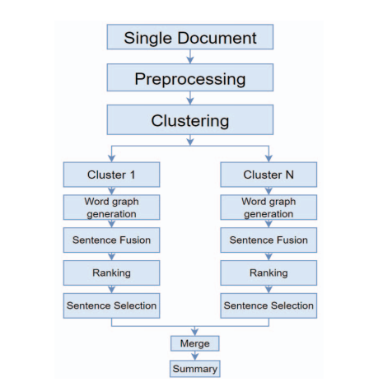
Methodology cont’d
They used BenSumm model to generate extractive summary
This output was fed to the T5 transfer model and the Hybrid model later
Since, the BenSumm is unsupervised, they did not train this model.
Figure 1: BenSumm model architecture from [1]

Slide 12
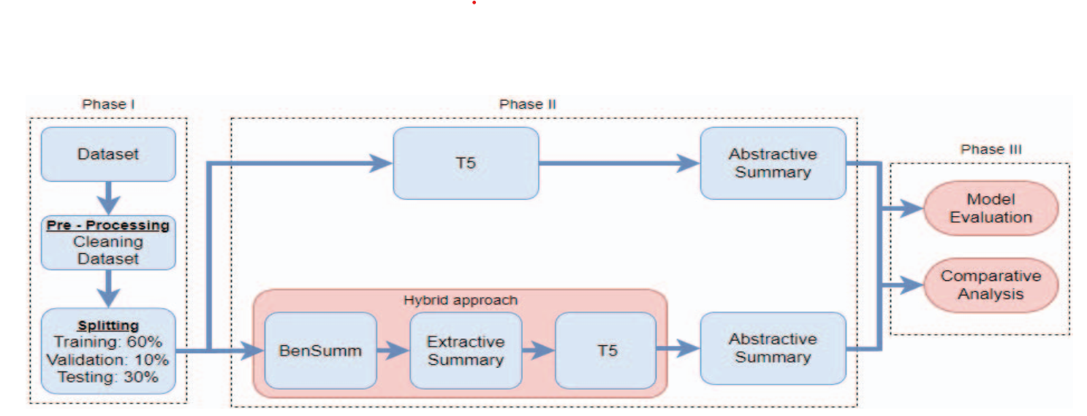
Methodology cont’d
Figure 2: Proposed Methodology in [1]

Slide 13
Methodology cont’d
TextRank, FCM and Aggregate Scoring [2]:
Applies TextRank
A graph-based ranking model
Identify key sentences based on their importance
Integrates Fuzzy C-Means clustering
Group similar sentences
Reduce redundancy.
Utilizes aggregate scoring
Combines various features to score and rank sentences.

Slide 14
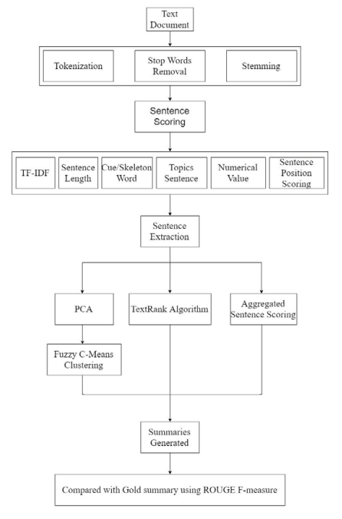
Methodology cont’d
Figure 3: System Workflow in [2]

Slide 15
Methodology cont’d
Hybrid Pointer Generator Network [3]:
Incorporates a sequence-to-sequence model with attention
Generates contextually relevant summaries.
Uses a pointer-generator network
Enables the model to copy words directly from the source text
Addresses out-of-vocabulary issues.
Implements a coverage mechanism
Ensures unique and concise summaries

Slide 16
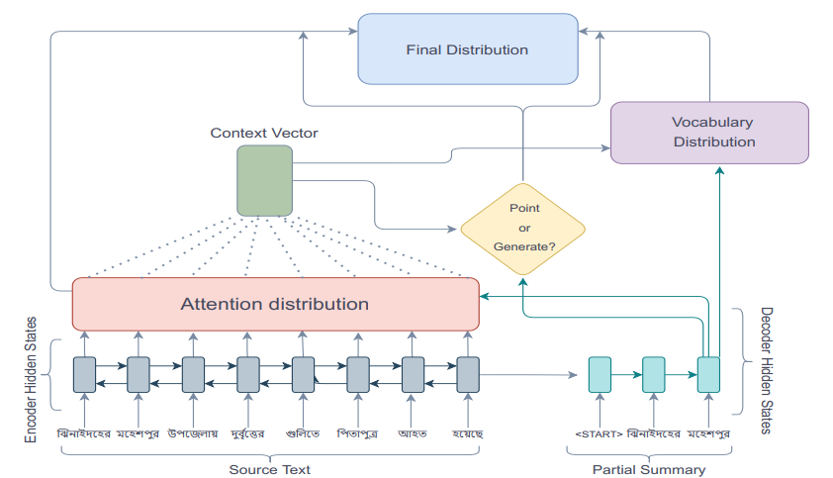
Methodology cont’d
Figure 4: Pointer Generator Network Architecture in [3]

Slide 17
Result Analysis and Comparison
T5 Transformer and Hybrid Approach [1]
Hybrid Pointer Generator Network [3]
Evaluation Metrics: ROUGE-1, ROUGE-2
Achieved ROUGE-1 score of 0.67 and ROUGE-2 score of 0.42 on BANS-133k dataset
Outperforms state-of-the-art Bengali abstractive summarization techniques.
Evaluation Metrics: ROUGE
Outperforms baseline extractive summarization systems
Efficiently identifies and ranks key sentences
Evaluation Metrics: ROUGE, BELU
High ROUGE and BLEU scores, indicating improved summarization quality. Efficiently identifies and ranks key sentences. improvement in human evaluation scores.
TextRank, Fuzzy C-Means, and Aggregate Scoring [2]

Slide 18
Recommendation and Findings
Contributions:
The T5 Transformer and Hybrid Approach [1] handles complex Bengali sentences effectively. Also maintains contextual integrity in summaries.
The TextRank, Fuzzy C-Means, and Aggregate Scoring Methods [2] are straightforward and highly effective for extractive summarization. Enhances the overall extraction process by integrating multiple text features and clustering techniques.
The Hybrid Pointer Generator Network [3] effectively handles out-of-vocabulary words. Coverage mechanism significantly reduces repetition. Maintains conceptual integrity and factual accuracy.

Slide 19
Recommendation and Findings cont’d
Limitations:
The T5 Transformer and Hybrid Approach [1] has high computational demands and requires longer training times.
The TextRank, Fuzzy C-Means, and Aggregate Scoring Methods [2] lack of fluidity and cohesion in generated summaries. Often fails to rephrase or integrate extracted sentences smoothly.
The Hybrid Pointer Generator Network [3] requires large datasets for training. This method is computationally demanding, making real-time applications challenging.

Slide 20
Recommendation and Findings cont’d
Recommendation:
Considering all aspects and objectives, I would recommend Hybrid Pointer Generator Network [3] approach for text summarization.
In spite of High computational demand, the output will be more accurate and coherent. It’s abstractive summary will also be generated after handling out-of-vocabulary words and repetitions.

Slide 21
Conclusion
We analyzed three papers to work on Bangla Text Summarization.
Each one of them used a different methodology and achieved success in individual ways.
This study analyzed strengths and weaknesses of three different approaches to Bengali text summarization.
Considering all necessary requirements, like abstraction, accuracy, handling multiple situations, The Hybrid Pointer Network [3] is recommended.

Slide 22
References
K. M. Hasib, M. A. Rahman, M. I. Masum, F. D. Boer, S. Azam, and A. Karim, "Bengali News Abstractive Summarization: T5 Transformer and Hybrid Approach," in Proc. 2023 Int. Conf. Digital Image Computing: Techniques and Applications (DICTA), Port Macquarie, Australia, 2023, pp. 539-545, doi: 10.1109/DICTA60407.2023.00080.
A. Rahman, F. M. Rafiq, R. Saha, R. Rafian, and H. Arif, "Bengali Text Summarization using TextRank, Fuzzy C-Means, and Aggregate Scoring methods," in Proc. 2019 IEEE Region 10 Symposium (TENSYMP), Kolkata, India, 2019, pp. 331-336, doi: 10.1109/TENSYMP46218.2019.8971039.
N. Dhar, G. Saha, P. Bhattacharjee, A. Mallick, and M. S. Islam, "Pointer over Attention: An Improved Bangla Text Summarization Approach Using Hybrid Pointer Generator Network," in Proc. 2021 24th Int. Conf. on Computer and Information Technology (ICCIT), Dhaka, Bangladesh, 2021, pp. 1-5, doi: 10.1109/ICCIT54785.2021.9689852.

Slide 23
References
P. Bhattacharjee, A. Mallick, M. S. Islam, and M. E. Jannat, "Bengali Abstractive News Summarization (BANS): A Neural Attention Approach," in Proceedings of International Conference on Trends in Computational and Cognitive Engineering, M. S. Kaiser, A. Bandyopadhyay, M. Mahmud, and K. Ray, Eds. Advances in Intelligent Systems and Computing, vol. 1309. Springer, Singapore, 2021. doi: 10.1007/978-981-33-4673-4_4.
R. R. Chowdhury, M. T. Nayeem, T. T. Mim, M. S. R. Chowdhury, and T. Jannat, "Unsupervised Abstractive Summarization of Bengali Text Documents," arXiv preprint arXiv:2102.04490, 2021. [Online]. Available: https://arxiv.org/abs/2102.04490.
N. Andhale and L. A. Bewoor, "An overview of Text Summarization techniques," 2016 International Conference on Computing Communication Control and Automation (ICCUBEA), Pune, India, 2016, pp. 1-7. doi: 10.1109/ICCUBEA.2016.7860024.

Slide 24
References
P. P. Ghosh, R. Shahariar, and M. A. H. Khan, "A Rule-Based Extractive Text Summarization Technique for Bangla News Documents," International Journal of Modern Education and Computer Science, vol. 10, no. 12, pp. 44-53, Dec. 2018. doi: 10.5815/ijmecs.2018.12.06.
P. B. Tumpa, S. Yeasmin, A. M. Nitu, M. P. Uddin, M. I. Afjal, and M. A. A. Mamun, "An Improved Extractive Summarization Technique for Bengali Text(s)," 2018 International Conference on Computer, Communication, Chemical, Material and Electronic Engineering (IC4ME2), Rajshahi, Bangladesh, 2018, pp. 1-4. doi: 10.1109/IC4ME2.2018.8465609.
bangla.bdnews24.com. Available: https://bangla.bdnews24.com/

Slide 25
Thank You

